Slide 1




Noida Institute of Engineering and Technology, Greater Noida
REINFORCEMENT LEARNING
AND
GENETIC ALGORITHM
Unit: 5
Subject Name:
Machine Learning Techniques
(ACSML0401)
Faculty Details:
Alisha Sikri
Assistant professor
AIML
Course Details: B.tech IV sem

Slide 2

Faculty Profile
Noida Institute of Engineering and Technology, Greater Noida
Name: Alisha Sikri
Qualification: PhD (Pursuing)
Specialization Areas: Machine Learning, Artificial Intelligence
COURSE | BOARD/UNIVERSITY | YEAR OF PASSING
PhD | SRM University, NCR | Pursuing
M.Tech | DCRUST University, Murthal | 2016
B.Tech | MDU, Rohtak | 2014

Slide 3

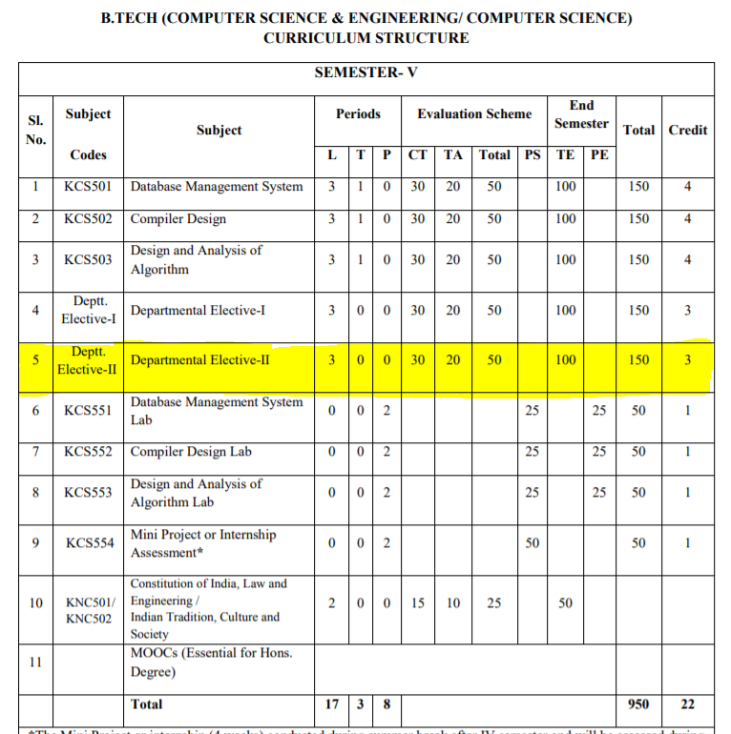
Evaluation Scheme

Slide 4
Syllabus
Unit-I : Introduction-
Learning, Types of Learning, Well defined learning problems, Designing a Learning System, History of ML, Introduction of Machine Learning Approaches – (Artificial Neural Network, Clustering, Reinforcement Learning, Decision Tree Learning, Bayesian networks, Support Vector Machine, Genetic Algorithm), Issues in Machine Learning and Data Science Vs Machine Learning
Unit-II : REGRESSION:
Linear Regression and Logistic Regression BAYESIAN LEARNING - Bayes theorem, Concept learning, Bayes Optimal Classifier, Naïve Bayes classifier, Bayesian belief networks, EM algorithm. SUPPORT VECTOR MACHINE: Introduction, Types of support vector kernel – (Linear kernel, polynomial kernel,and Gaussiankernel), Hyperplane – (Decision surface), Properties of SVM, and Issues in SVM.
Unit-III : DECISION TREE LEARNING - Decision tree learning algorithm, Inductive bias, Inductive inference with decision trees, Entropy and information theory, Information gain, ID-3 Algorithm, Issues in Decision tree learning. INSTANCE-BASED LEARNING – k-Nearest Neighbour Learning, Locally Weighted Regression, Radial basis function networks, Case-based learning.

Slide 5
Syllabus
Unit-IV : ARTIFICIAL NEURAL NETWORKS –
Perceptron’s, Multilayer perceptron, Gradient descent and the Delta rule, Multilayer networks, Derivation of Backpropagation Algorithm, Generalization, Unsupervised Learning – SOM Algorithm and its variant; DEEP LEARNING - Introduction,concept of convolutional neural network , Types of layers – (Convolutional Layers , Activation function , pooling , fully connected) , Concept of Convolution (1D and 2D) layers, Training of network, Case study of CNN for eg on Diabetic Retinopathy, Building a smart speaker, Self-deriving car etc..
Unit-V : REINFORCEMENT LEARNING–Introduction to Reinforcement Learning , Learning Task,Example of Reinforcement Learning in Practice, Learning Models for Reinforcement – (Markov Decision process , Q Learning - Q Learning function, Q Learning Algorithm ), Application of Reinforcement Learning,Introduction to Deep Q Learning. GENETIC ALGORITHMS: Introduction, Components, GA cycle of reproduction, Crossover, Mutation, Genetic Programming, Models of Evolution and Learning, Applications

Slide 6
Branch wise Application
Virtual Personal Assistants
Predictions while Commuting
Videos Surveillance
Social Media Services
Email Spam and Malware Filtering
Online Customer Support
Search Engine Result Refining
Product Recommendations
Online Fraud Detection

Slide 7
Course Objectives
This course will serve as a comprehensive introduction to various topics in machine learning
To introduce students to the basic concepts and techniques of Machine Learning.
To become familiar with regression methods, classification methods, clustering methods.
To introduce the concept of Decision Tree Learning and Instance-based Learning
To become familiar with Artificial Neural Networks and Deep Learning
To introduce the concept of Reinforcement Learning and Genetic Algorithms

Slide 8
Course Outcomes
At the end of the course, the student should be able to
COURSE OUTCOME NO | COURSE OUTCOMES
CO1 | To understand the need for machine learning for various problem solving
CO2 | To understand a wide variety of learning algorithms and how to evaluate models generated from data
CO3 | To understand the latest trends in machine learning
CO4 | To design appropriate machine learning algorithms and apply the algorithms to a real-world problems
CO5 | To optimize the models learned and report on the expected accuracy that can be achieved by applying the models

Slide 9
Course Outcomes
1. Engineering knowledge
2. Problem analysis
3. Design/development of solutions
4. Conduct investigations of complex problems
5. Modern tool usage
6. The engineer and society
7. Environment and sustainability
8. Ethics
9. Individual and team work
10. Communication
11. Project management and finance
12. Life-long learning

Slide 10
CO-PO Mapping
CO MAPPING WITH PO
CO. No. | PO1 | PO2 | PO 3 | PO 4 | PO 5 | PO 6 | PO 7 | PO 8 | PO 9 | PO 10 | PO 11 | PO 12
1 | 3 | 3 | 3 | 1 |  |  |  |  | 1 |  |  | 2
2 | 3 | 3 | 3 | 1 |  |  |  |  | 1 |  |  | 1
3 | 3 | 3 | 3 | 1 |  | 1 |  |  | 1 |  |  | 1
4 | 3 | 3 | 3 | 1 |  |  |  |  | 1 |  |  | 2
5 | 3 | 3 | 3 | 2

Slide 11
Program Specific Outcome (PSO)
On successful completion of graduation degree, The computer Science & Engineering graduates will be able to:
PSO1: identify, analyze real world problems and design their ethical solutions using artificial intelligence, robotics, virtual/augmented reality, data analytics, block chain technology, and cloud computing.
PSO2: design and develop the hardware sensor devices and related interfacing software systems for solving complex engineering problems.
PSO 3: understand inter-disciplinary computing techniques and to apply them in the design of advanced computing.
PSO 4: conduct investigation of complex problem with the help of technical, managerial, leadership qualities, and modern engineering tools provided by industry sponsored laboratories.

Slide 12
CO-PSO Mapping
CO MAPPING WITH PSO
CO/PSO | POS1 | POS2 | POS3 | POS4
CO 1 | 3 | 1 | 1 | -
CO 2 | 3 | 2 | - | -
CO 3 | 3 | 2 | - | -
CO 4 | 3 | 2 | 2 | 1
CO 5 | 3 | 2 | 1 | -

Slide 13
PEOs
PEO 1: To have an excellent scientific and engineering breadth so as to comprehend, analyze, design and provide sustainable solutions for real-life problems using state-of-the-art technologies.
PEO 2: To have a successful career in industries, to pursue higher studies or to support entrepreneurial endeavors and to face the global challenges.
PEO 3:To have an effective communication skills, professional attitude, ethical values and a desire to learn specific knowledge in emerging trends, technologies for research, innovation and product development and contribution to society.
PEO 4: To have life-long learning for up-skilling and re-skilling for successful professional career as engineer, scientist, entrepreneur and bureaucrat for betterment of society.

Slide 14
CO-PSO Mapping
CO. NO. | PSO1 | PSO2 | PSO3 | PSO4
1 | 1 | 2
2 | 1 | 2 | 1 | 1
3 | 2 | 1 | 1 | 2
4 | 1 | 1 | 1 | 2
5 | 1 | 1 | 1

Slide 15
Result Analysis
MLT(KCS-055)
Subject wise result | 95.62
Faculty wise result | 92.65

Slide 16
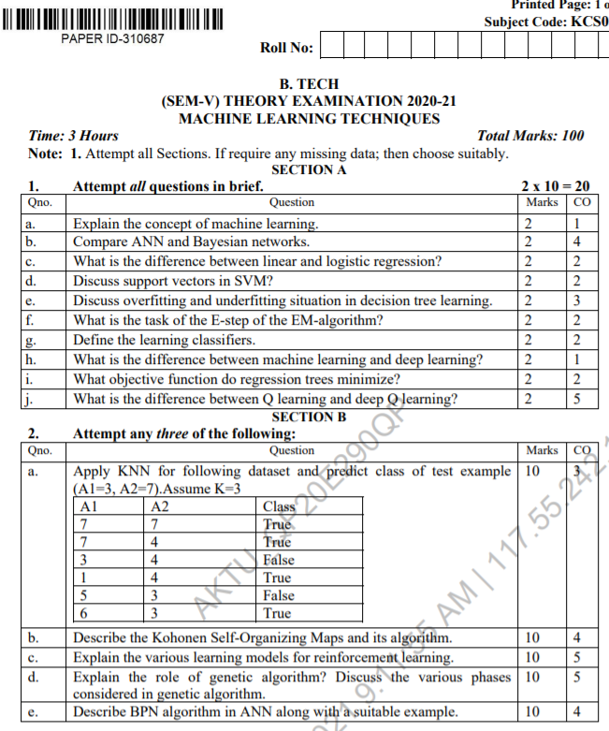
End Sem Question Papers Format

Slide 17
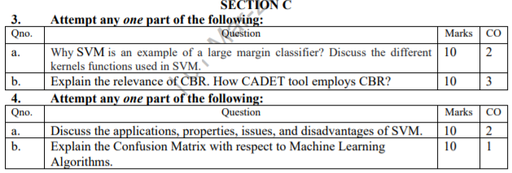
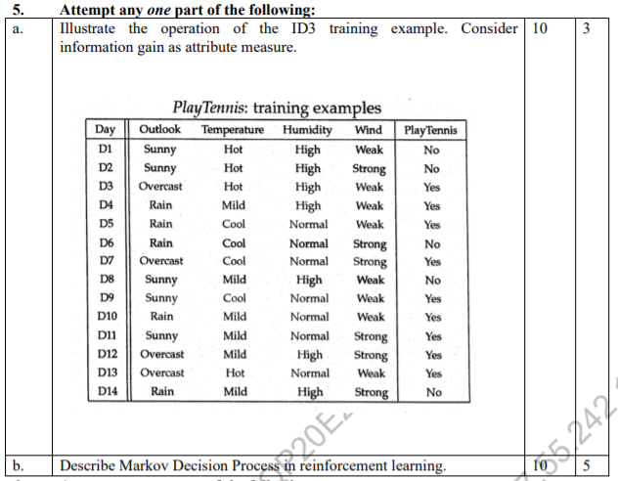
End Sem Question Papers Format

Slide 18
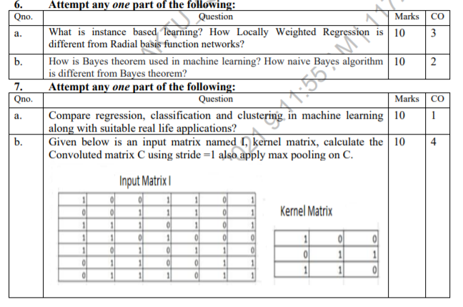
End Sem Question Papers Format

Slide 19
Prerequisite
To get started with Machine Learning you must be familiar with the following
concepts:
Algebra
variables, coefficients, and functions
linear equations such as y=b+w1x1+w2x2
logarithms, and logarithmic equations such as y=ln(1+ez)
sigmoid function
Linear algebra
tensor and tensor rank
matrix multiplication

Slide 20
Prerequisite
Trigonometry
Tan h (discussed as an activation function; no prior knowledge needed)
Calculus (optional, for advanced topics)
concept of a derivative (you won't have to actually calculate derivatives)
gradient or slope
partial derivatives (which are closely related to gradients)
chain rule (for a full understanding of the backpropagation algorithm for training neural networks)

Slide 21
Pre-requisite
Programming language:
It is essential to know programming languages like R and Python in order to implement the whole Machine Learning process. Python and R both provide in-built libraries that make it very easy to implement Machine Learning algorithms.

Slide 22
Contents
REINFORCEMENT LEARNING:
Introduction to Reinforcement Learning,
Learning Task,
Example of Reinforcement Learning in Practice
Learning Models for Reinforcement – (Markov Decision process, Q Learning – Q Learning function,
Q Learning Algorithm)
Application of Reinforcement Learning
Introduction to Deep Q Learning.

Slide 23
Contents
GENETIC ALGORITHMS:
Introduction,
Components,
GA cycle of reproduction,
Crossover, Mutation
Genetic Programming
Models of Evolution and Learning,
Applications.

Slide 24
Objectives of Unit
Mainly the unit’s objectives are:
Conceptualization and summarization of reinforcement learning: To introduce students to the learning tasks and techniques with the help of example based on game (Q learning).
The unit introduces a number of popular optimization methods used in genetic algorithms.
Introducing the working principles of GAs, present GA applications/case studies from a wide variety of engineering problems.

Slide 25
Unit Outcomes
At the end of the course the students should be able to design and implement machine learning solutions to classification, regression, and clustering problems.
Illustrate the steps involved in designing a self machine learning algorithm.
Construct optimization algorithms using genetic algorithm for complex applications.

Slide 26
Topic Mapping with CO
GENETIC ALGORITHMS:
GA-an illustrative example (CO5)
Hypothesis space search (CO5)
Genetic Programming (CO5)
Models of Evolution and Learning (CO5)
Learning first order rules (CO5)
sequential covering algorithms (CO5)
General to specific beam search (CO5)

Slide 27
Topic Mapping with CO
REINFORCEMENT LEARNING :
The Learning Task (CO5)
Q Learning (CO5)

Slide 28
REINFORCEMENT LEARNING
Reinforcement Learning is a feedback-based Machine learning technique in which an agent learns to behave in an environment by performing the actions and seeing the results of actions. For each good action, the agent gets positive feedback, and for each bad action, the agent gets negative feedback or penalty.
In Reinforcement Learning, the agent learns automatically using feedbacks without any labeled data, unlike supervised learning.
Since there is no labeled data, so the agent is bound to learn by its experience only.
RL solves a specific type of problem where decision making is sequential, and the goal is long-term, such as game-playing, robotics, etc.

Slide 29
REINFORCEMENT LEARNING
The agent interacts with the environment and explores it by itself. The primary goal of an agent in reinforcement learning is to improve the performance by getting the maximum positive rewards.
The agent learns with the process of hit and trial, and based on the experience, it learns to perform the task in a better way. Hence, we can say that "Reinforcement learning is a type of machine learning method where an intelligent agent (computer program) interacts with the environment and learns to act within that." How a Robotic dog learns the movement of his arms is an example of Reinforcement learning.

Slide 30
TYPES OF REINFORCEMENT LEARNING
There are mainly two types of reinforcement learning, which are:
Positive Reinforcement
Negative Reinforcement
Positive Reinforcement:
The positive reinforcement learning means adding something to increase the tendency that expected behavior would occur again. It impacts positively on the behavior of the agent and increases the strength of the behavior.
This type of reinforcement can sustain the changes for a long time, but too much positive reinforcement may lead to an overload of states that can reduce the consequences.

Slide 31
TYPES OF REINFORCEMENT LEARNING
2. Negative Reinforcement:
The negative reinforcement learning is opposite to the positive reinforcement as it increases the tendency that the specific behavior will occur again by avoiding the negative condition.
It can be more effective than the positive reinforcement depending on situation and behavior, but it provides reinforcement only to meet minimum behavior.

Slide 32
APPROACHES TO IMPLEMENT REINFORCEMENT LEARNING
There are mainly three ways to implement reinforcement-learning in ML, which are:
Value-based:
The value-based approach is about to find the optimal value function, which is the maximum value at a state under any policy. Therefore, the agent expects the long-term return at any state(s) under policy π.
2. Policy-based:
Policy-based approach is to find the optimal policy for the maximum future rewards without using the value function. In this approach, the agent tries to apply such a policy that the action performed in each step helps to maximize the future reward.

Slide 33
APPROACHES TO IMPLEMENT REINFORCEMENT LEARNING
The policy-based approach has mainly two types of policy:
Deterministic: The same action is produced by the policy (π) at any state.
Stochastic: In this policy, probability determines the produced action.
3. Model-based: In the model-based approach, a virtual model is created for the environment, and the agent explores that environment to learn it. There is no particular solution or algorithm for this approach because the model representation is different for each environment.

Slide 34
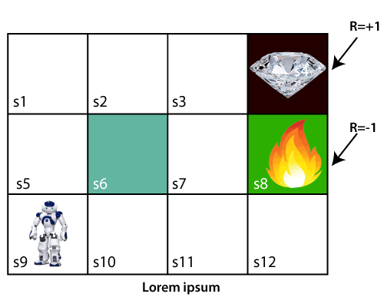
WORKING REINFORCEMENT LEARNING
The working process of the RL, we need to consider two main things:
Environment: It can be anything such as a room, maze, football ground, etc.
Agent: An intelligent agent such as AI robot.
Let's take an example of a maze environment that the agent needs to explore. Consider the below image:

Slide 35
WORKING REINFORCEMENT LEARNING
In the above image, the agent is at the very first block of the maze. The maze is consisting of an S₆ block, which is a wall, S₈ a fire pit, and S₄ a diamond block.
The agent cannot cross the S₆ block, as it is a solid wall. If the agent reaches the S₄ block, then get the +1 reward; if it reaches the fire pit, then gets -1 reward point. It can take four actions: move up, move down, move left, and move right.
The agent can take any path to reach to the final point, but he needs to make it in possible fewer steps. Suppose the agent considers the path S9-S5-S1-S2-S3, so he will get the +1-reward point.

Slide 36
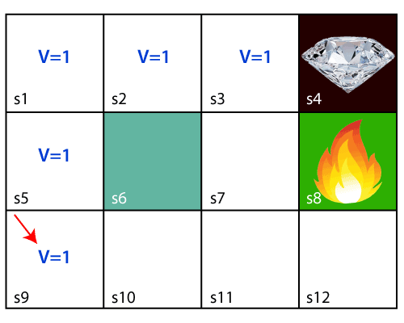
WORKING REINFORCEMENT LEARNING
The agent will try to remember the preceding steps that it has taken to reach the final step. To memorize the steps, it assigns 1 value to each previous step.
Consider the below step:

Slide 37
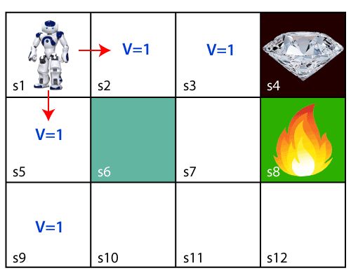
WORKING REINFORCEMENT LEARNING
Now, the agent has successfully stored the previous steps assigning the 1 value to each previous block. But what will the agent do if he starts moving from the block, which has 1 value block on both sides?
Consider the below diagram:

Slide 38
WORKING REINFORCEMENT LEARNING
It will be a difficult condition for the agent whether he should go up or down as each block has the same value. So, the above approach is not suitable for the agent to reach the destination. Hence to solve the problem, we will use the Bellman equation, which is the main concept behind reinforcement learning.

Slide 39
BELLMAN’s EQUATION
The Bellman equation was introduced by the Mathematician Richard Ernest Bellman in the year 1953, and hence it is called as a Bellman equation.
It is associated with dynamic programming and used to calculate the values of a decision problem at a certain point by including the values of previous states.
It is a way of calculating the value functions in dynamic programming or environment that leads to modern reinforcement learning.

Slide 40
BELLMAN’s EQUATION
The key-elements used in Bellman equations are:
Action performed by the agent is referred to as "a"
State occurred by performing the action is "s."
The reward/feedback obtained for each good and bad action is "R."
A discount factor is Gamma "γ.“
The Bellman equation can be written as:
V(s) = max [R(s,a) + γV(s`)]
Where,
V(s)= value calculated at a particular point.
R(s,a) = Reward at a particular state s by performing an action.
γ = Discount factor
V(s`) = The value at the previous state.

Slide 41
BELLMAN’s EQUATION
Using the Bellman equation, we will find value at each state of the given environment. We will start from the block, which is next to the target block.
For 1st block:
V(s3) = max [R(s,a) + γV(s`)], here V(s')= 0 because there is no further state to move.
V(s3)= max[R(s,a)]=> V(s3)= max[1]=> V(s3)= 1.
For 2nd block:
V(s2) = max [R(s,a) + γV(s`)], here γ= 0.9(lets), V(s')= 1, and R(s, a)= 0, because there is no reward at this state.
V(s2)= max[0.9(1)]=> V(s)= max[0.9]=> V(s2) =0.9

Slide 42
BELLMAN’s EQUATION
For 3rd block:
V(s1) = max [R(s,a) + γV(s`)], here γ= 0.9(lets), V(s')= 0.9, and R(s, a)= 0, because there is no reward at this state also.
V(s1)= max[0.9(0.9)]=> V(s3)= max[0.81]=> V(s1) =0.81
For 4th block:
V(s5) = max [R(s,a) + γV(s`)], here γ= 0.9(lets), V(s')= 0.81, and R(s, a)= 0, because there is no reward at this state also.
V(s5)= max[0.9(0.81)]=> V(s5)= max[0.81]=> V(s5) =0.73
For 5th block:
V(s9) = max [R(s,a) + γV(s`)], here γ= 0.9(lets), V(s')= 0.73, and R(s, a)= 0, because there is no reward at this state also.
V(s9)= max[0.9(0.73)]=> V(s4)= max[0.81]=> V(s4) =0.66

Slide 43
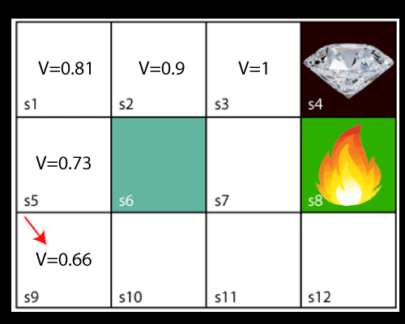
BELLMAN’s EQUATION
Consider the below image:
Now, we will move further to the 6th block, and here agent may change the route because it always tries to find the optimal path. So now, let's consider from the block next to the fire pit.

Slide 44
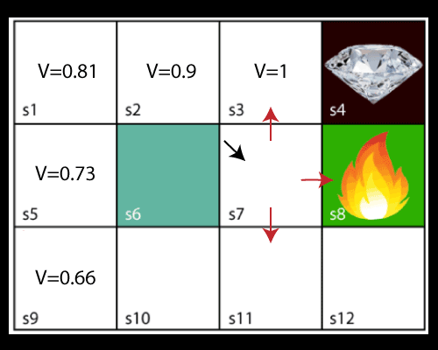
BELLMAN’s EQUATION
Now, the agent has three options to move; if he moves to the blue box, then he will feel a bump if he moves to the fire pit, then he will get the -1 reward. But here we are taking only positive rewards, so for this, he will move to upwards only. The complete block values will be calculated using this formula.

Slide 45
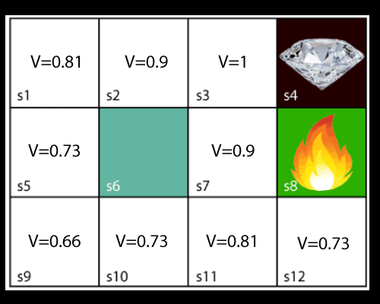
BELLMAN’s EQUATION
Consider the below image:

Slide 46
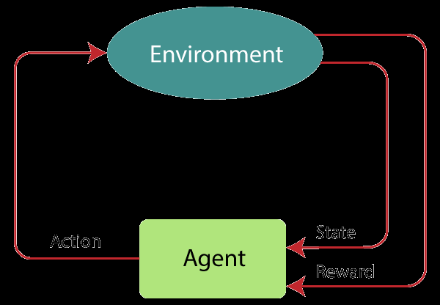
MARKOV DECISION PROCESS
Markov Decision Process or MDP, is used to formalize the reinforcement learning problems.
If the environment is completely observable, then its dynamic can be modeled as a Markov Process.
In MDP, the agent constantly interacts with the environment and performs actions; at each action, the environment responds and generates a new state.

Slide 47
MARKOV DECISION PROCESS
MDP is used to describe the environment for the RL, and almost all the RL problem can be formalized using MDP.
MDP contains a tuple of four elements (S, A, P_{a}, R_{a}):
A set of finite States S
A set of finite Actions A
Rewards received after transitioning from state S to state S', due to action a.
Probability P_{a}.

Slide 48
MARKOV PROPERTY
It says that "If the agent is present in the current state S1, performs an action a1 and move to the state s2, then the state transition from s1 to s2 only depends on the current state and future action and states do not depend on past actions, rewards, or states."
Or, in other words, as per Markov Property, the current state transition does not depend on any past action or state. Hence, MDP is an RL problem that satisfies the Markov property. Such as in a Chess game, the players only focus on the current state and do not need to remember past actions or states.
Finite MDP:
A finite MDP is when there are finite states, finite rewards, and finite actions. In RL, we consider only the finite MDP.

Slide 49
REINFORCEMENT LEARNING ALGORITHMS
Reinforcement learning algorithms are mainly used in AI applications and gaming applications.
The main used algorithms are:
Q-Learning:
Q-learning is an Off policy RL algorithm, which is used for the temporal difference Learning. The temporal difference learning methods are the way of comparing temporally successive predictions.
The Q stands for quality in Q-learning, which means it specifies the quality of an action taken by the agent.
It learns the value function Q (S, a), which means how good to take action "a" at a particular state "s."

Slide 50
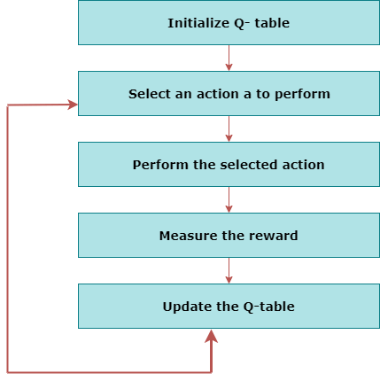
FLOWCHART OF Q- LEARNING

Slide 51

EXPLAINATION OF Q-LEARNING
Q-learning is a popular model-free reinforcement learning algorithm based on the Bellman equation.
The main objective of Q-learning is to learn the policy which can inform the agent that what actions should be taken for maximizing the reward under what circumstances.
It is an off-policy RL that attempts to find the best action to take at a current state.
The goal of the agent in Q-learning is to maximize the value of Q.
The value of Q-learning can be derived from the Bellman equation.

Slide 52
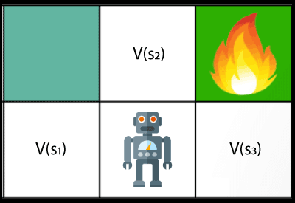
EXPLAINATION OF Q-LEARNING
In the equation, we have various components, including reward, discount factor (γ), probability, and end states s'. But there is no any Q-value is given so first consider the below image:

Slide 53
EXPLAINATION OF Q-LEARNING
In the above image, we can see there is an agent who has three values options, V(s₁), V(s₂), V(s₃). As this is MDP, so agent only cares for the current state and the future state. The agent can go to any direction (Up, Left, or Right), so he needs to decide where to go for the optimal path. Here agent will take a move as per probability bases and changes the state.
But if we want some exact moves, so for this, we need to make some changes in terms of Q-value.

Slide 54
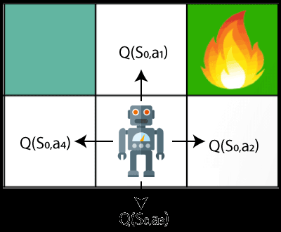
EXPLAINATION OF Q-LEARNING
Q- represents the quality of the actions at each state. So instead of using a value at each state, we will use a pair of state and action, i.e., Q(s, a). Q-value specifies that which action is more lubricative than others, and according to the best Q-value, the agent takes his next move.

Slide 55


EXPLAINATION OF Q-LEARNING
The Bellman equation can be used for deriving the Q-value.
To perform any action, the agent will get a reward R(s, a), and also he will end up on a certain state, so the Q -value equation will be:
Hence, we can say that, V(s) = max [Q(s, a)]
The above formula is used to estimate the Q-values in Q-Learning.

Slide 56
Q-Learning — a simplistic overview
Let’s say that a robot has to cross a maze and reach the end point.
There are mines, and the robot can only move one tile at a time. If
the robot steps onto a mine, the robot is dead. The robot has to
reach the end point in the shortest time possible.

Slide 57
Q-Learning — a simplistic overview
The scoring/reward system is as below:
1. The robot loses 1 point at each step. This is done so that the robot takes the shortest path and reaches the goal as fast as possible.
2. If the robot steps on a mine, the point loss is 100 and the game ends.
3. If the robot gets power ⚡ , it gains 1 point.
4. If the robot reaches the end goal, the robot gets 100 points.

Slide 58
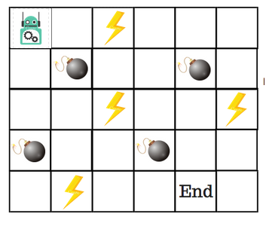
Q-Learning — a simplistic overview
End goal with the shortest path without stepping on a mine?
So, how do we solve this?

Slide 59
Introducing the Q-Table
Q-Table is just a fancy name for a simple lookup table where we
calculate the maximum expected future rewards for action at each
state. Basically, this table will guide us to the best action at each
state.
There will be four numbers of actions at each non-edge tile. When a robot is at a state it can either move up or down or right or left.

Slide 60
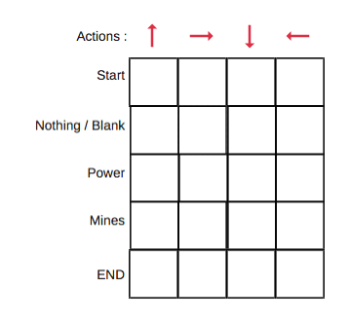
Introducing the Q-Table
So, let’s model this environment in our Q-Table. In the Q-Table,
the columns are the actions and the rows are the states.

Slide 61
Introducing the Q-Table
Each Q-table score will be the maximum expected future.
Reward that the robot will get if it takes that action at that state.
This is an iterative process, as we need to improve the Q-Table at each iteration.
But the questions are:
Are the values available or predefined?
To learn each value of the Q-table, we use the Q-Learning
algorithm.

Slide 62
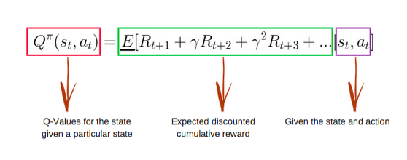
Mathematics: the Q-Learning algorithm
Q-function
The Q-function uses the Bellman equation and takes two inputs:
state (s) and action (a).

Slide 63
Mathematics: the Q-Learning algorithm
Q-function
Using the above function, we get the values of Q for the cells in the table.
When we start, all the values in the Q-table are zeros.
There is an iterative process of updating the values.
As we start to explore the environment, the Q-function gives us better and better approximations by continuously updating the Q-values in the table.

Slide 64
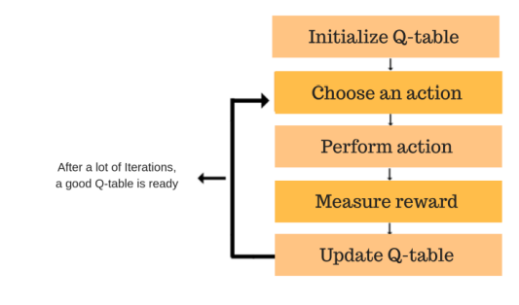
Mathematics: the Q-Learning algorithm
Q-function
Now, let’s understand how the updating takes place.
Each of the colored boxes is one step. Let’s understand each of these steps in detail.

Slide 65
Step 1: initialize the Q-Table
We will first build a Q-table.
There are n columns, where n= number of actions.
There are m rows, where m= number of states.
We will initialise the values at 0.

Slide 66
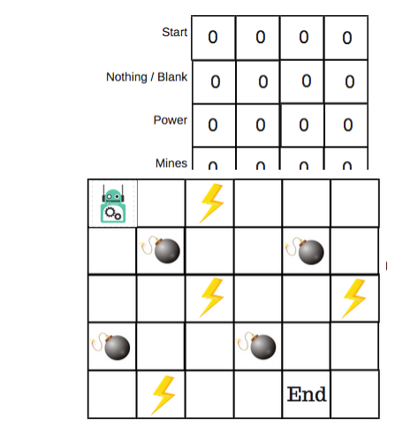
Step 1: initialize the Q-Table

Slide 67
Steps 2 and 3: choose and perform an
action
This combination of steps is done for an undefined amount of time.
This means that this step runs until the time we stop the training, or the training loop stops as defined in the code.
We will choose an action (a) in the state (s) based on the Q-Table.
But, as mentioned earlier, when the episode initially starts, every Q-value is 0.

Slide 68
Steps 2 and 3: choose and perform an
action
We’ll use something called the epsilon greedy strategy.
In the beginning, the epsilon rates will be higher.
The robot will explore the environment and randomly choose actions.
The logic behind this is that the robot does not know anything about the environment.

Slide 69
Steps 2 and 3: choose and perform an
action
As the robot explores the environment, the epsilon rate decreases and the robot starts to exploit the environment.
During the process of exploration, the robot progressively becomes more confident in estimating the Q-values.
For the robot example, there are four actions to choose from: up, down, left, and right.
We are starting the training now — our robot knows nothing about the environment. So the robot chooses a random action, say right.

Slide 70
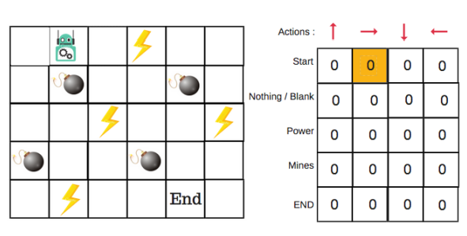
Steps 2 and 3: choose and perform an
action
We can now update the Q-values for being at the start and moving right using the Bellman equation.

Slide 71
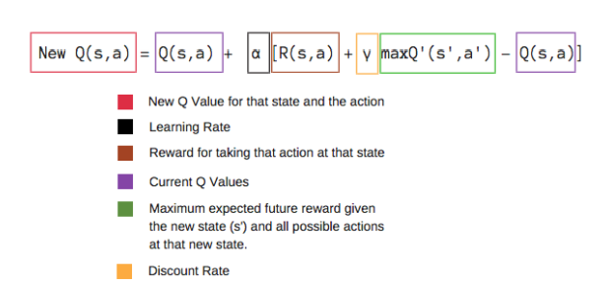
Steps 4 and 5: evaluate
Now we have taken an action and observed an outcome and
reward. We need to update the function Q(s,a).

Slide 72
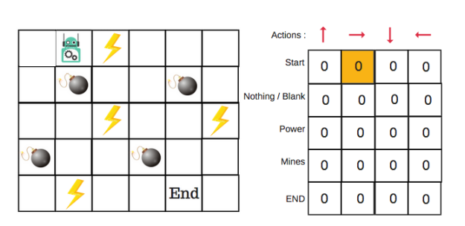
Steps 4 and 5: evaluate
In the case of the robot game, to reiterate the scoring/reward structure is:
power = +1
mine = -100
end = +100

Slide 73
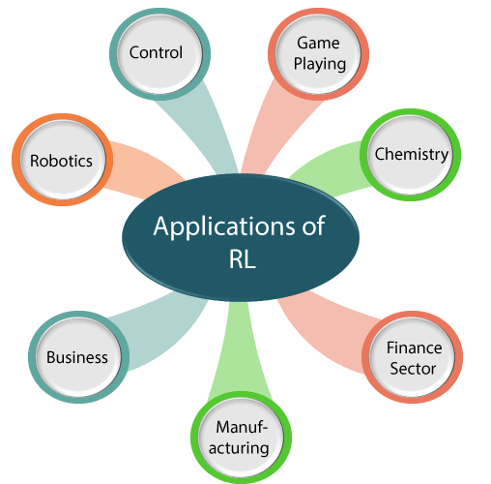
REINFORCEMENT LEARNING APPLICATIONS

Slide 74
REINFORCEMENT LEARNING APPLICATIONS
Robotics: RL is used in Robot navigation, Robo-soccer, walking, juggling, etc.
Control: RL can be used for adaptive control such as Factory processes, admission control in telecommunication, and Helicopter pilot is an example of reinforcement learning.
Game Playing: RL can be used in Game playing such as tic-tac-toe, chess, etc.
Chemistry: RL can be used for optimizing the chemical reactions.
Business: RL is now used for business strategy planning.
Manufacturing: In various automobile manufacturing companies, the robots use deep reinforcement learning to pick goods and put them in some containers.
Finance Sector: The RL is currently used in the finance sector for evaluating trading strategies.

Slide 75
GENETIC ALGORITHM
A genetic algorithm is a search-based algorithm used for solving optimization problems in machine learning. This algorithm is important because it solves difficult problems that would take a long time to solve.
A genetic algorithm (GA) is a heuristic search algorithm used to solve search and optimization problems.
This algorithm is a subset of evolutionary algorithms, which are used in computation.
Genetic algorithms employ the concept of genetics and natural selection to provide solutions to problems.

Slide 76
EXPLAINATION OF GA
The following are some of the basic terminologies that can help us to understand genetic algorithms:
Population: This is a subset of all the probable solutions that can solve the given problem.
Chromosomes: A chromosome is one of the solutions in the population.
Gene: This is an element in a chromosome.
Allele: This is the value given to a gene in a specific chromosome.
Fitness function: This is a function that uses a specific input to produce an improved output. The solution is used as the input while the output is in the form of solution suitability.
Genetic operators: In genetic algorithms, the best individuals mate to reproduce an offspring that is better than the parents. Genetic operators are used for changing the genetic composition of this next generation.

Slide 77
APPLICATION OF GA
It has excellent parallel capabilities.
It can optimize various problems such as discrete functions, multi-objective problems, and continuous functions.
It provides answers that improve over time.
A genetic algorithm does not need derivative information.

Slide 78
WORKING OF GA
Five phases are considered in a genetic algorithm.
Initial population
Fitness function
Selection
Crossover
Mutation

Slide 79
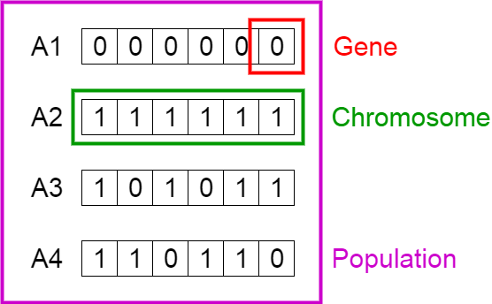
WORKING OF GA
1. Initial Population
The process begins with a set of individuals which is called a Population. Each individual is a solution to the problem you want to solve.
An individual is characterized by a set of parameters (variables) known as Genes. Genes are joined into a string to form a Chromosome (solution).
In a genetic algorithm, the set of genes of an individual is represented using a string, in terms of an alphabet. Usually, binary values are used (string of 1s and 0s). We say that we encode the genes in a chromosome.

Slide 80
WORKING OF GA
2. Fitness Function
The fitness function determines how fit an individual is (the ability of an individual to compete with other individuals). It gives a fitness score to each individual. The probability that an individual will be selected for reproduction is based on its fitness score.
3. Selection
The idea of selection phase is to select the fittest individuals and let them pass their genes to the next generation.
Two pairs of individuals (parents) are selected based on their fitness scores. Individuals with high fitness have more chance to be selected for reproduction.

Slide 81
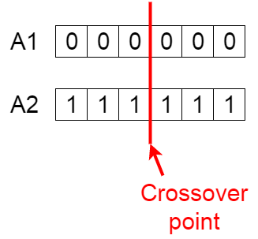
WORKING OF GA
4. Crossover
Crossover is the most significant phase in a genetic algorithm. For each pair of parents to be mated, a crossover point is chosen at random from within the genes.
For example, consider the crossover point to be 3 as shown below.

Slide 82
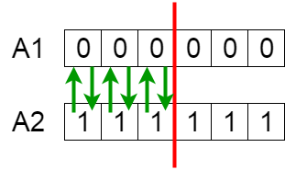
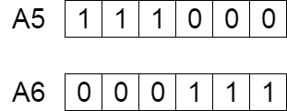
WORKING OF GA
5. Offspring
Offsprings are created by exchanging the genes of parents among themselves until the crossover point is reached.
The new offspring are added to the population.

Slide 83
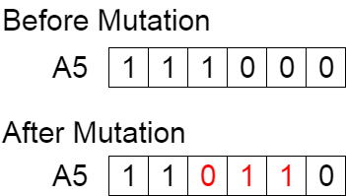
WORKING OF GA
5. Mutation
In certain new offspring formed, some of their genes can be subjected to a mutation with a low random probability. This implies that some of the bits in the bit string can be flipped.
Mutation occurs to maintain diversity within the population and prevent premature convergence.

Slide 84
WORKING OF GA
6. Termination
The algorithm terminates if the population has converged (does not produce offspring which are significantly different from the previous generation). Then it is said that the genetic algorithm has provided a set of solutions to our problem.

Slide 85
LIMITATIONS OF GA
Like any technique, GAs also suffer from a few limitations. These include −
GAs are not suited for all problems, especially problems which are simple and for which derivative information is available.
Fitness value is calculated repeatedly which might be computationally expensive for some problems.
Being stochastic, there are no guarantees on the optimality or the quality of the solution.
If not implemented properly, the GA may not converge to the optimal solution.

Slide 86
Faculty Video Links, Youtube & NPTEL Video Links and Online Courses Details
Youtube/Other Video Links:
1. Machine Learning by Prof. Balaraman ravindran, Department of computer science and engineering,IIT Madras (SWAYAM/NPTEL)
https://www.youtube.com/watch?v=fC7V8QsPBec&feature=youtu.be
2. Machine Learning by Prof. Sudeshna Sarkar, Department of computer science and engineering,IIT Kharagpur (NPTEL)
https://www.youtube.com/watch?v=EWmCkVfPnJ8&list=PLlGkyYYWOSOsGU-XARWdIFsRAJQkyBrVj&index=2
3. Machine learning UPGRAD course by IIIT,Bangalore
https://www.upgrad.com/machine-learning-ai-pgd-iiitb/

Slide 87
Daily Quiz
1. Genetic algorithms are heuristic methods that do not guarantee an optimal solution to a problem
True
False
2. Any physical event that affects a sensory cell so an individual can detect the event is called
reinforcement.
a stimulus.
a reward.
learning.

Slide 88
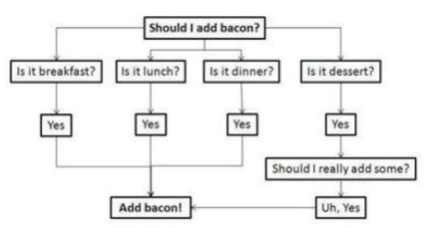
Daily Quiz
3. The data is split according to a certain requirements
Decision tree learning
Reinforcement learning
Predictive models
sentiment analysis

Slide 89
Daily Quiz
5. In the choice phase of problem solving, normative models involve selecting an optimal or best outcome
True
False
6. Analytical techniques for problem solving are best for unstructured rather than structured problems.
A. True.
B. False

Slide 90
Daily Quiz
7.Discrete events and agent-based models are usually used for middle or low levels of abstraction
True
False
8. How does blind search differ from optimization
Blind search cannot result in optimal solutions whereas optimization methods
Blind search represents a guided approach while optimization is unguided
Blind search usually does not conclude in one step like some optimization methods
Blind search is usually a more efficient problem solving approach than optimization

Slide 91
Daily Quiz
9. Which approach is most suited to complex problems with significant uncertainty, a need for experimentation, and time compression?
Simulation
Optimization
human intuition
genetic algorithms
10. In which stage of the simulation methodology do you determine the variables and gather data
Defining the problem
constructing the simulation model
testing and validating the model
designing the experiment

Slide 92
Weekly Assignment
Explain Q learning algorithm assuming deterministic rewards andaction
Describe Reduced Error Pruning
What is Rule Post Pruning
What is Reinforcement Learning?

Slide 93
Weekly Assignment
5. Explain the Q function and Q Learning Algorithm.
6. Explain FOIL algorithm
7. Differentiate between FOIL & Sequential Covering.
8. Explain genetic algorithm
9. How do we represent GP for image classification.
10. Define Genetic Programming.

Slide 94
MCQ s
1. All of the following are suitable problems for genetic algorithms EXCEPT
dynamic process control
pattern recognition with complex patterns
simulation of biological models
simple optimization with few variables
2. What kind of learning algorithm for "Facial identities or facial expressions"?
Recognizing Anomalies
Prediction
Generating Patterns
Recognition Patterns

Slide 95
MCQ s
3.If a single system is used for packaging, there are increased chances of endogenous material being packed. a) True b) False
4.Parameters that affect GA A: initial population B: selection process C: fitness function D: all of these
5. Fitness function should be
A: maximum
B: minimum
C: intermediate
D: noneof these

Slide 96
Expected Questions for University Exam
Explain how genetic algorithms are influenced by knowledge based techniques. Also discuss the how Genetic Algorithm is different from traditional algorithms?
Explain Q Learning.
Explain the role of genetic algorithm in knowledge based technique.
Differentiate between Genetic algorithm & traditional algorithm with suitable example.

Slide 97
Summary
FOIL extension of CN2
• General-to-speciﬁc search adding new literals
• Literals may introduce new variables
• Foil-Gains used as evaluation function
• FOIL has been shown to successfully learn recursive rule sets
• To handle noisy data, some tradeoff between accuracy, coverage, and complexity tells it when to stop adding new literals
• FOIL also performs post-pruning

Slide 98
Old Question Papers

Slide 99
Old Question Papers

Slide 100
Old Question Papers

Slide 101
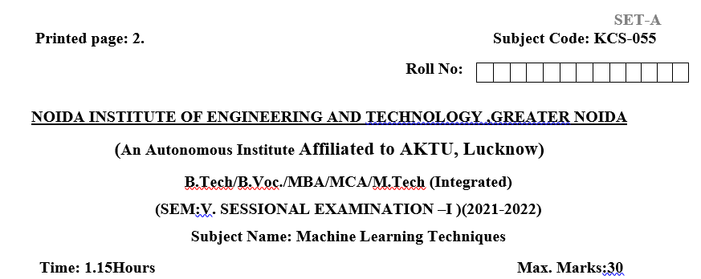
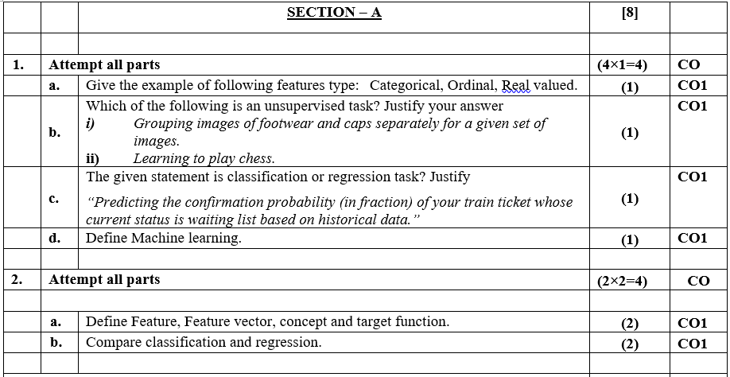
Sessional Question Papers

Slide 102
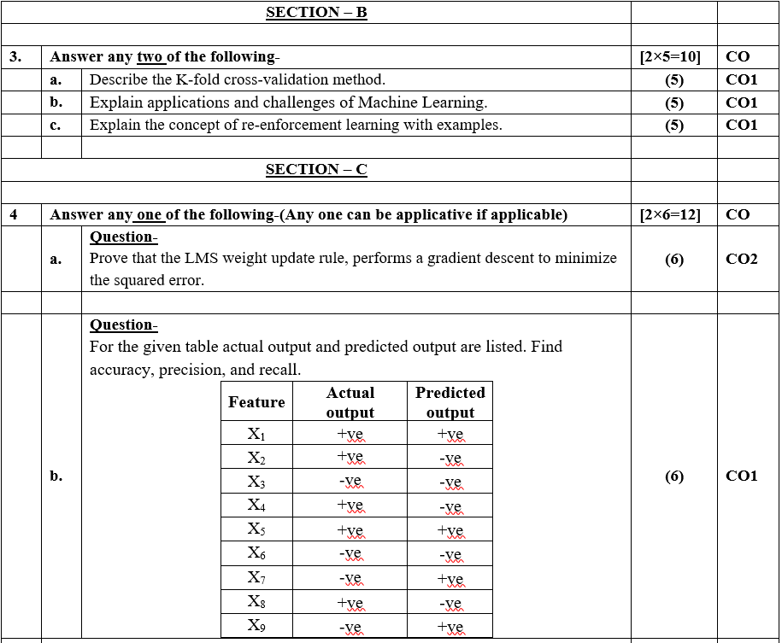
Sessional Question Papers

Slide 103
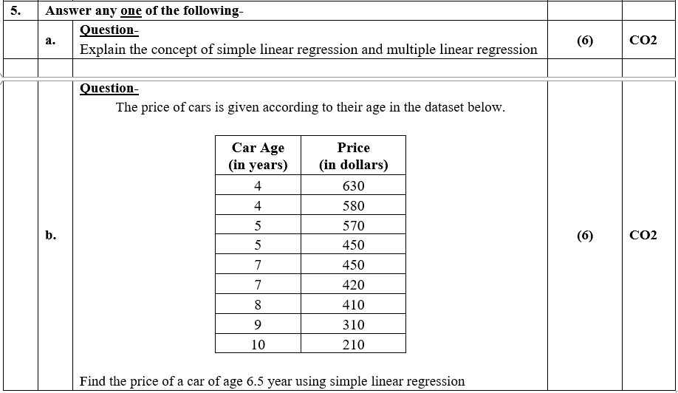
Sessional Question Papers

Slide 104
Glossary Questions
1. Choose correct option
i)2 ii)3 iii) Positive iv)Reinforcement learning
_______is all about making decisions sequentially
_________Reinforcement is defined as when an event, occurs due to a particular behavior.
There are _______ types of reinforcement.
Reinforcement learning is one of ______ basic machine learning paradigms
2. Choose correct option
i)Reinforcement ii)Supervised learning iii)Unsupervised
-------is the machine learning algorithms that can be used with labeled data.
--------is the machine learning algorithms that can be used with labeled data.
-------- is the machine learning algorithms that can be used with self learning with environment

Slide 105
Recap
Reinforcement Learning
Learning
Learning Models for Reinforcement – (Markov Decision process , Q Learning - Q Learning function, Q Learning Algorithm ),
Application of Reinforcement Learning,Introduction to Deep Q Learning.
GENETIC ALGORITHMS:

Slide 106
References
Reference Books:
Introduction to Statistical Learning, Springer, 2013 By Gareth James, Daniela Witten, Trevor Hastie, Robert Tibshirani.
Pattern Classification, 2nd Ed., John Wiley & Sons, 2001, Richard Duda, Peter Hart, David Stork.
Machine Learning, McGraw Hill International Edition, by Tom.M.Mitchell.
Introduction to Machine Learning, Eastern Economy Edition, Prentice Hall of India, 2005 By Ethern Alpaydin.
Pattern Recognition and Machine Learning. Berlin: Springer-Verlag., Bishop, C.

Slide 107
Thank You

